Slide 1
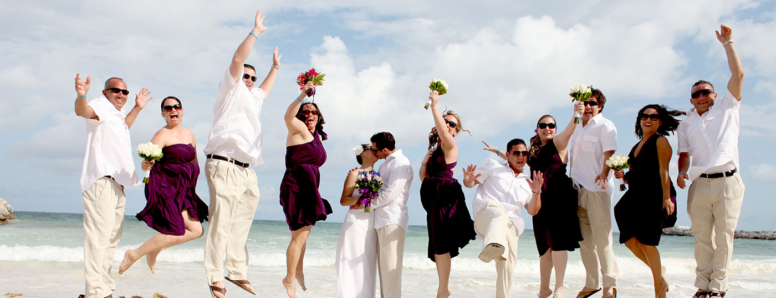
Let’s Celebrate
Invitations, using Modal Auxiliaries
Teacher Ms. Chiquete

Slide 2
Modal Auxiliaries to make requests
Teacher Ms. Chiquete

Slide 3
Can - Could
Modal verbs are used in English to make polite requests.
Can and could are modal verbs used to make requests. Here is the structure:
Can – Could + subject + verb ?
Examples: Can you pass the salt please?
Could you bring your book tomorrow?

Slide 4
Would / Will
Would / Will are also used to make requests. Here is the structure:
Would/Will + subject + verb + complement?
Examples: Would you like to call later?
Will you lend me some money?

Slide 5
May
May is used to ask for permission. Here is the structure:
May + Subject + verb + complement?
Examples: May I go to the bathroom?
May I go out for a moment?

Slide 6
Vocabulary

Slide 7
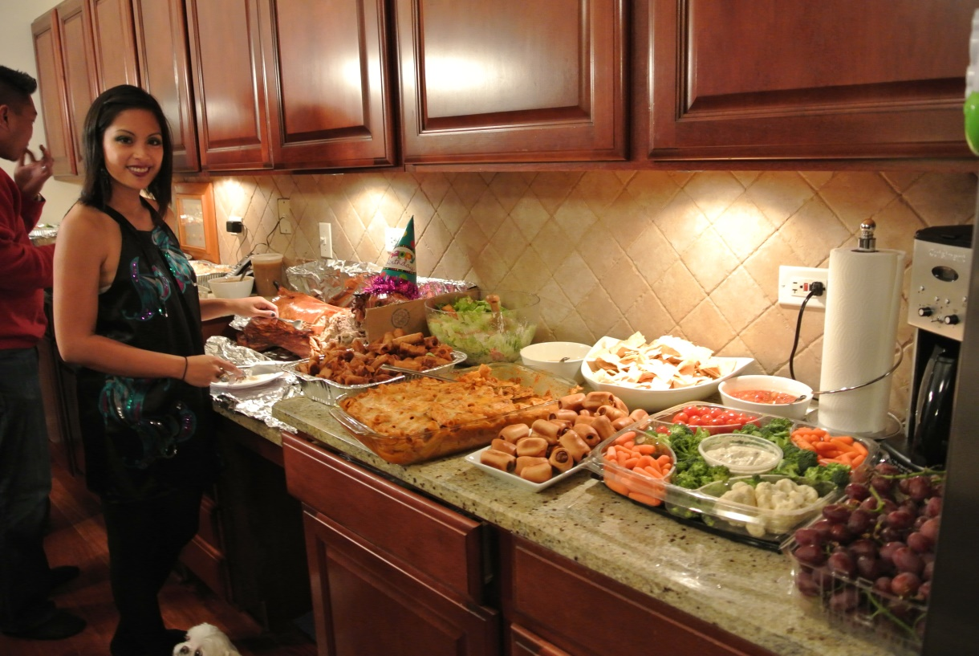
A host

Slide 8
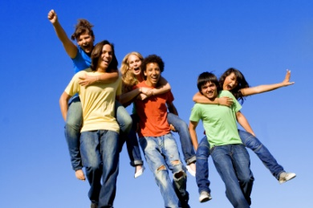
celebrate

Slide 9
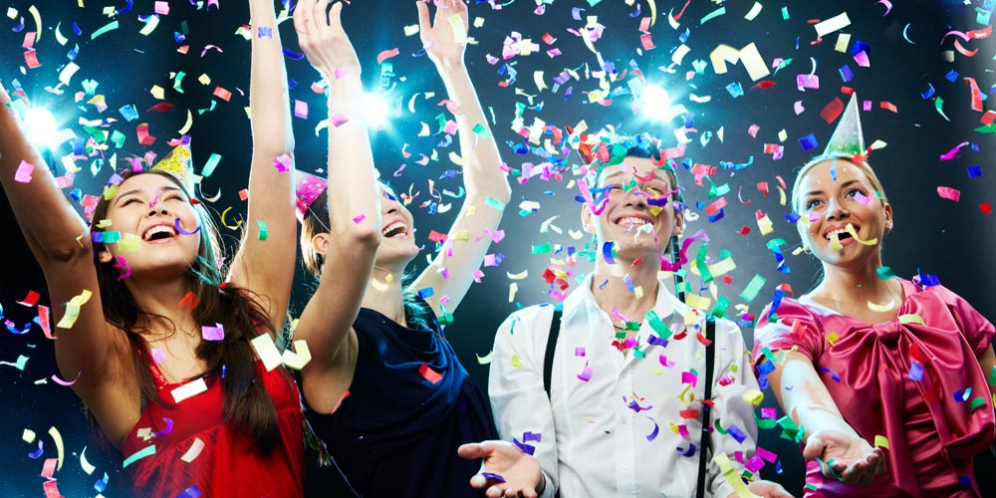
celebration

Slide 10
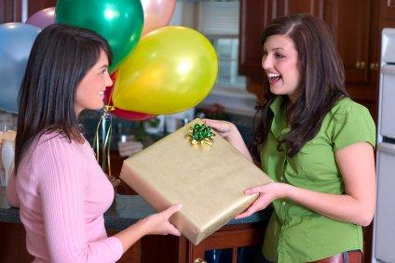
Get presents

Slide 11
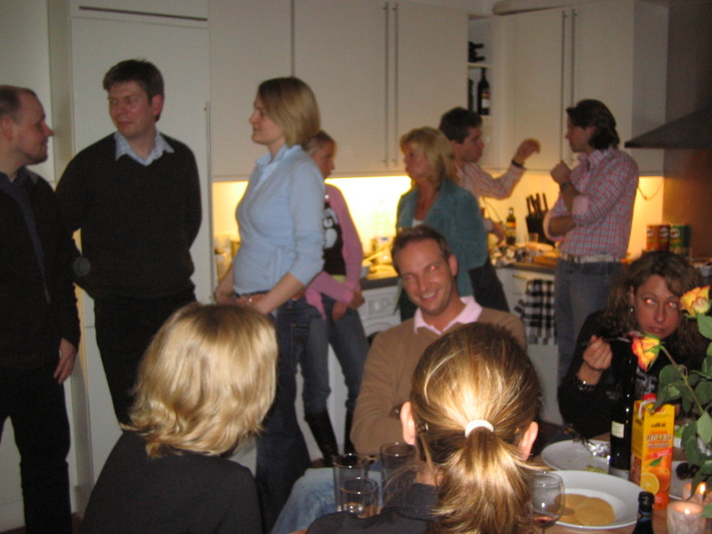
Get together

Slide 12
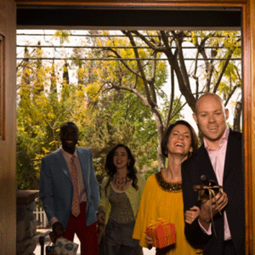
Have a party

Slide 13
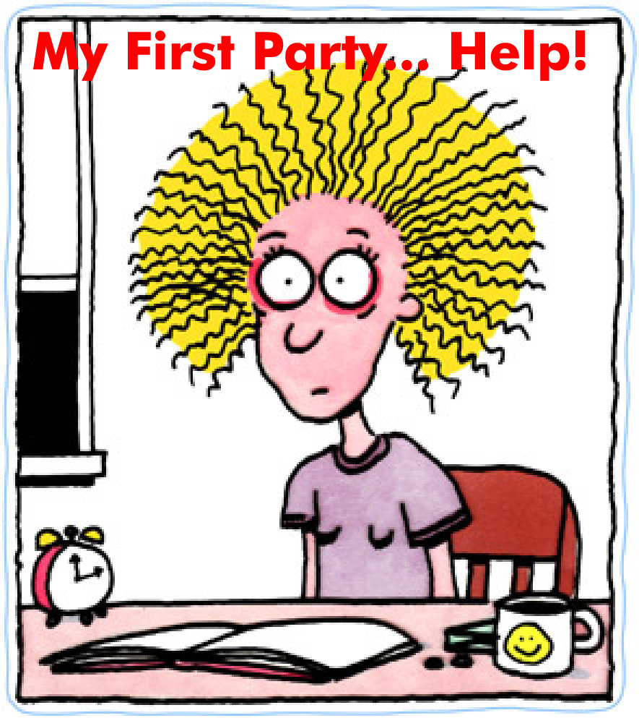
Throw a party

Slide 14
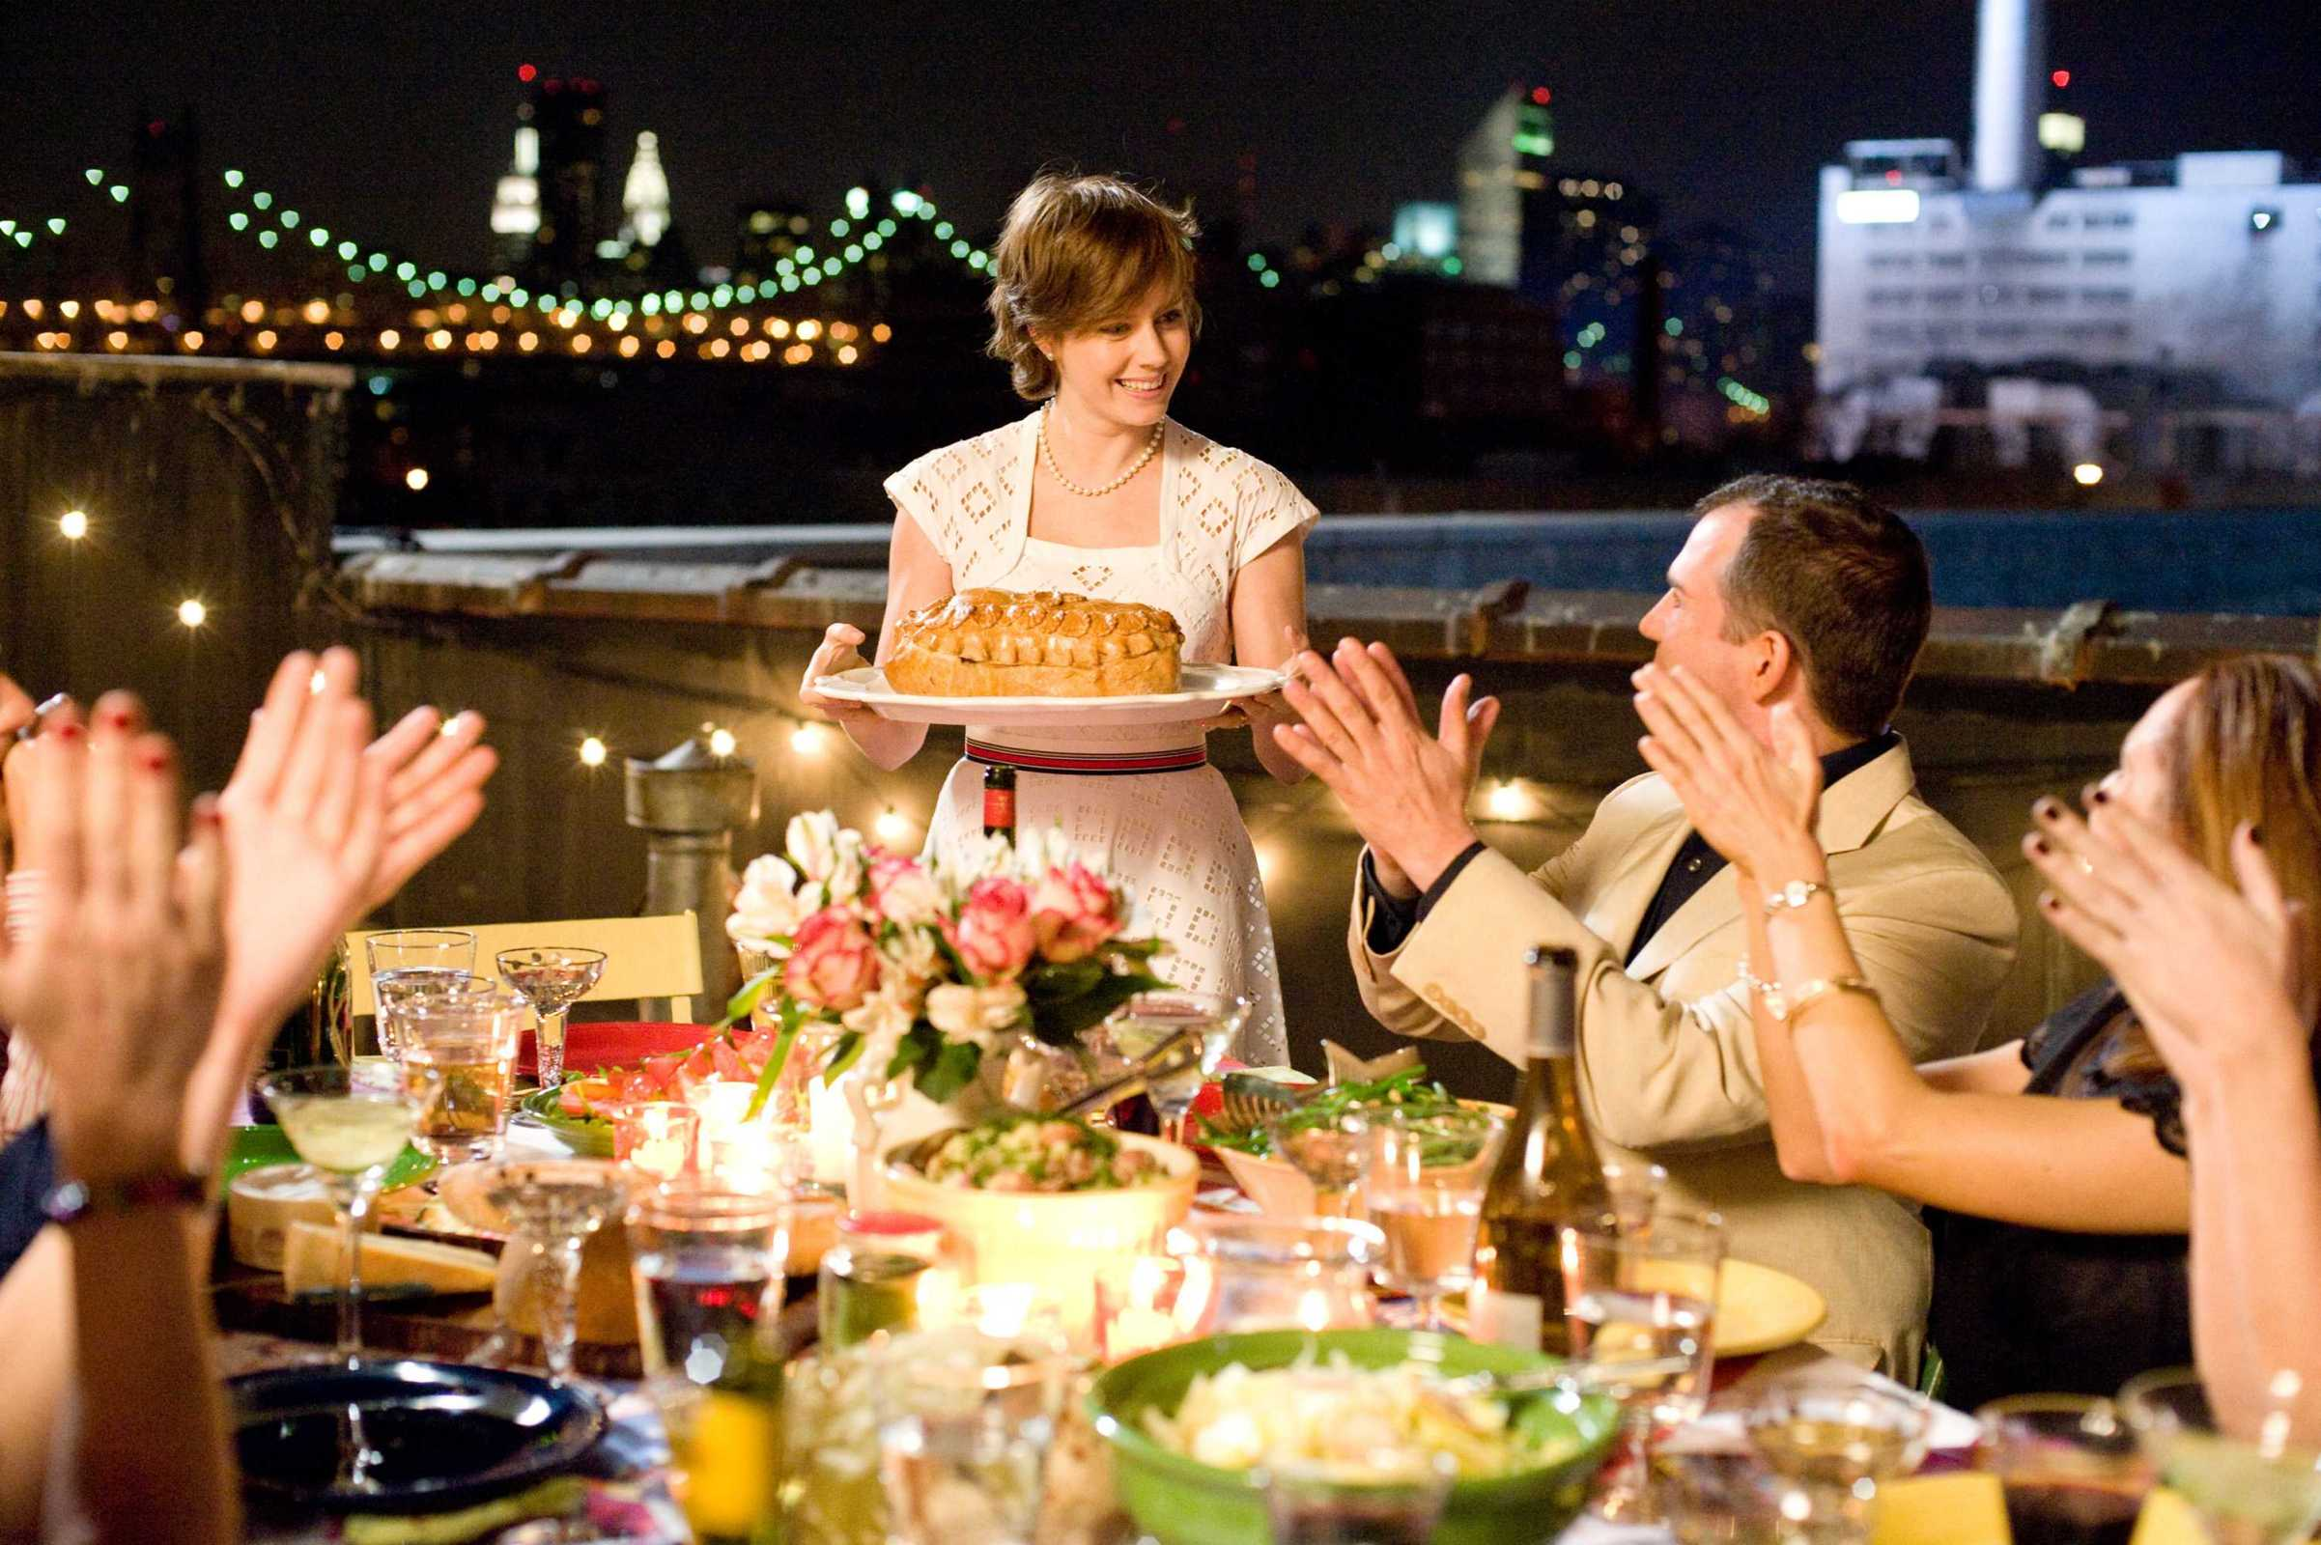
Host a party

Slide 15
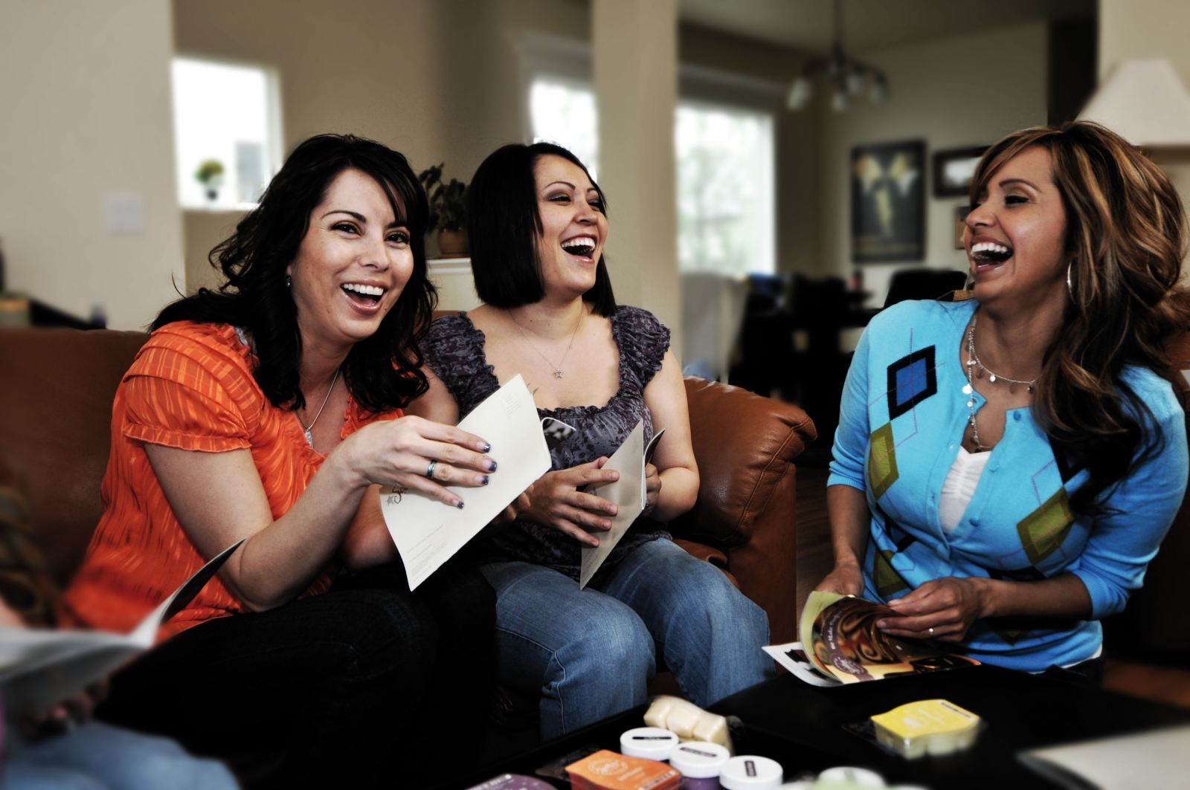
Have a good time

Slide 16
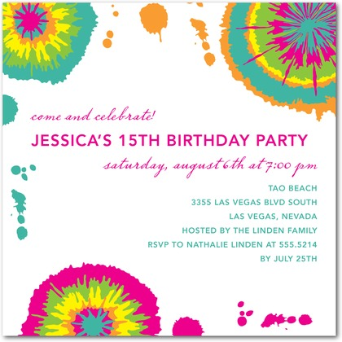
Invite
Invitation

Slide 17
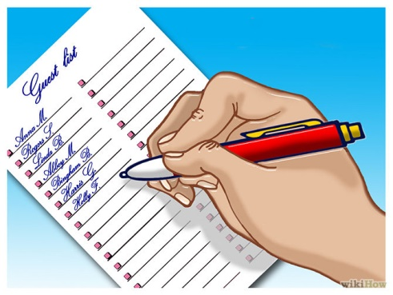
Plan a party

Slide 18

A rave

Slide 19
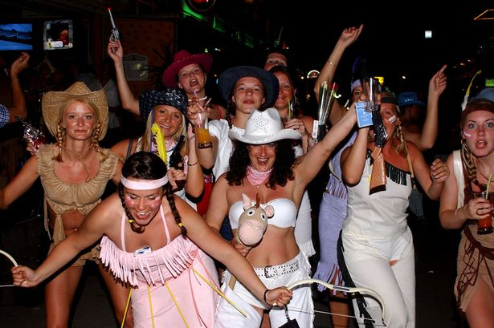
wild / rowdy

Slide 20


Birthday girl / boy

Slide 21

Spotlights /light show

Slide 22

gifts

Slide 23
guest

Slide 24
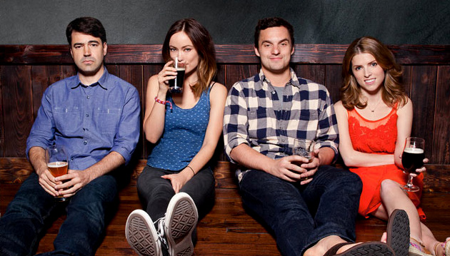
buddies

Slide 25
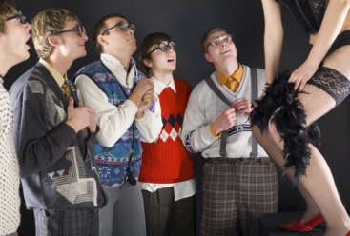
bachelor

Slide 26
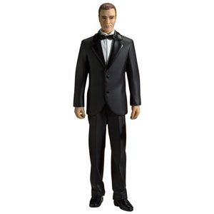
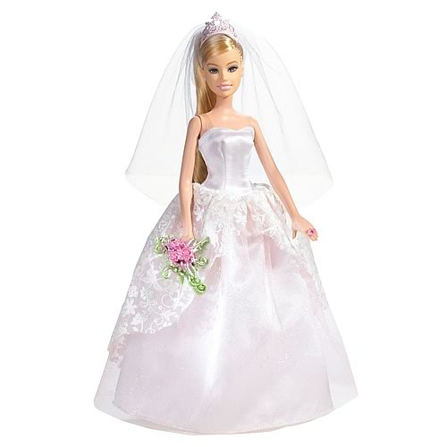
Groom / Bride

Slide 27
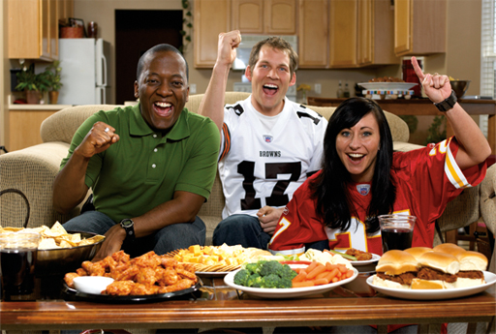
Football (party)

Slide 28
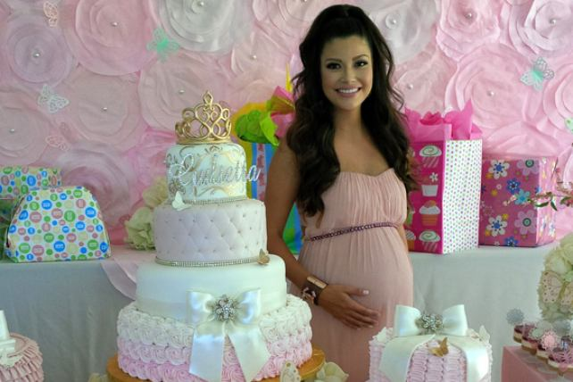
Pregnant / mother to be
Expectant mother

Slide 29
Howsewarming
party

Slide 30
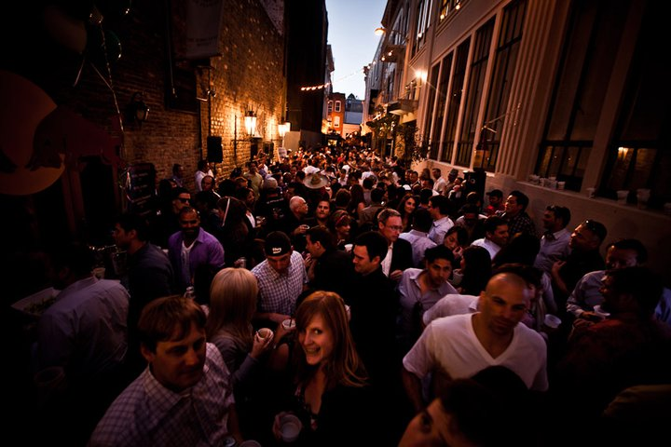
Block party

Slide 31
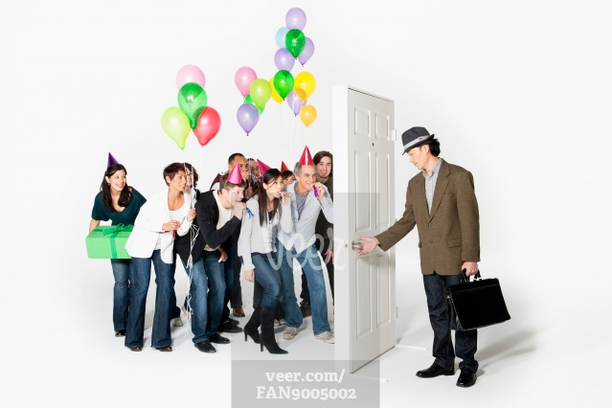
Surprise party

Slide 32
Baby shower

Slide 33
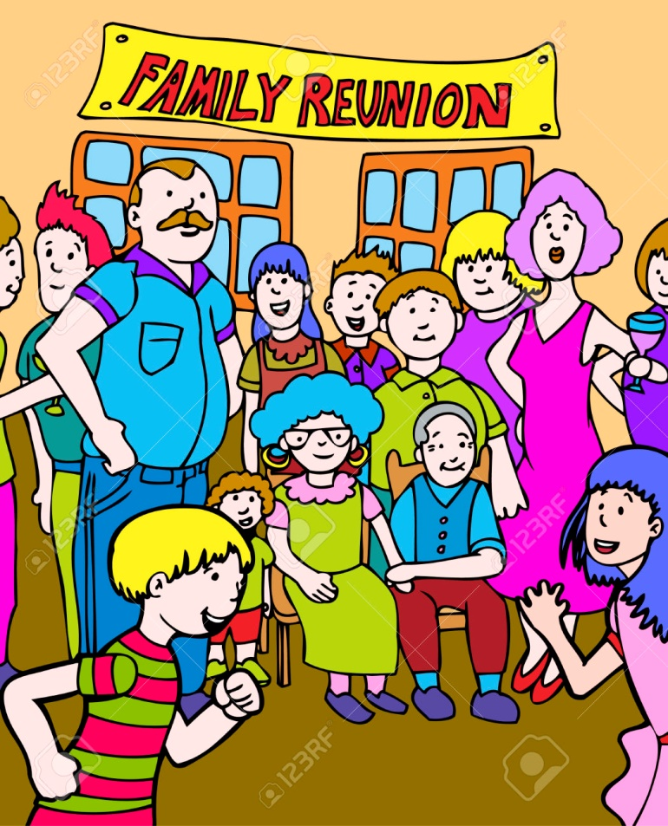
Family reunion

Slide 34
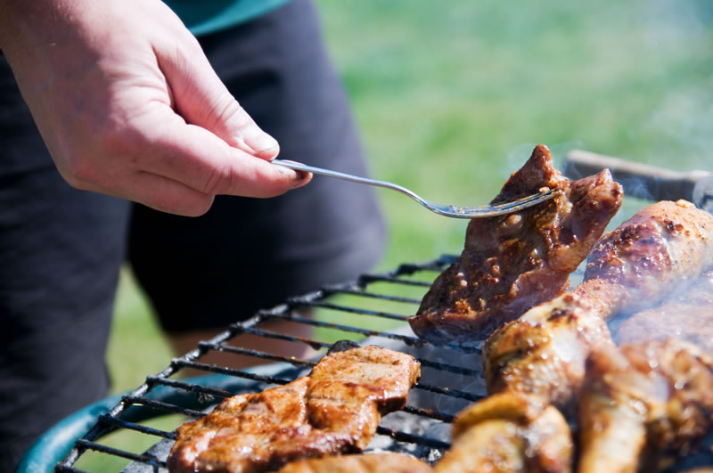
barbecue

Slide 35
Wedding

Slide 36

Bachelor party

Slide 37
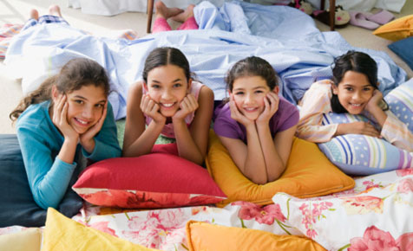
Slumber party

Slide 38

Go out to a disco
Go to party

Slide 39

Birthday party

Slide 40

Quinceañera party

Slide 41
Repeat the vocabulary

Slide 42
A host

Slide 43
Celebrate

Slide 44
Celebration

Slide 45
Get presents

Slide 46
Get together

Slide 47
Have a party

Slide 48
Throw a party

Slide 49
Host a party

Slide 50
Have a good time

Slide 51
Invite
Invitation

Slide 52
Plan a party

Slide 53
A rave

Slide 54
wild / rowdy

Slide 55
Birthday girl / boy

Slide 56
Spotlights /light show

Slide 57
Gifts

Slide 58
Guest

Slide 59
Buddies

Slide 60
Bachelor

Slide 61
Groom / Bride

Slide 62
Football (party)

Slide 63
Pregnant / mother to be
Expectant mother

Slide 64
Howsewarming
party

Slide 65
Block party

Slide 66
Surprise party

Slide 67
Baby shower

Slide 68
Family reunion

Slide 69
barbecue

Slide 70
Wedding

Slide 71
Bachelor party

Slide 72
Slumber party

Slide 73
Go out to a disco
Go to party

Slide 74
Birthday party

Slide 75
Quinceañera party

